Slide 1
Lab 4: Implement
Vu Tuan Hai

Slide 2
Week | Topic | Homework
1 | Overview about the workspace of a software engineer | Project plan Setup workspace
2 | Analysis | Usecase diagram Sequence diagram
3 | Design | Class diagram Database diagram UI / UX prototype
4 | Implement | N/A (coding)
5 | Testing | N/A (coding)
6 | Evaluation the project | Complete project

Slide 3
Implementation
As you can see, coding takes about under 20% in the development cycle.

Slide 4
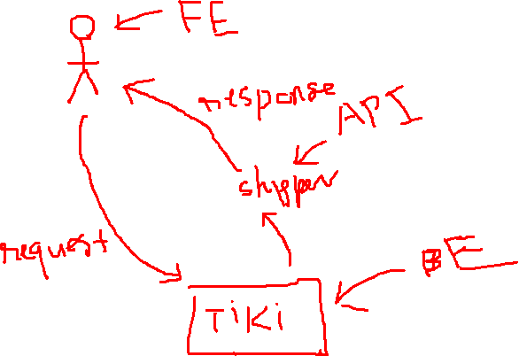
Web application
GUI
User see
User interaction
FE developer see
Front-end
HTML – CSS
Javascript (React, Vue, …)
API
Back-end
Java (J2EE), C# (.NET), Python (Flask, Django), …
Connector / Driver
BE developer see
Database
MySQL, SQLite, MSAccess, …

Slide 5





















Front-end
HTLM tag
Make up
CSS attribute
Control
Javascript
API

Slide 6
Back-end
API
Controller
Service
Data access
Database

Slide 7
















Data transfer object
HTLM tag
node module
Presentation layer
CSS attribute
.js
.html
.png
.css
Javascript
API
index.html
Controller
Business layer
object
Service
Develop kit
Data access
Data access layer
object
Database

Slide 8
Manage source code
If members are developed in the same branch:
- git pull at morning
- git push at afternoon
Otherwise:
- Each branch will be a separated feature/task.
- Feature branches should be merged to the "main" branch at the end of each sprint (Conflict between branches will be terrible). After that, all members check out and pull source code at the "main" branch.

Slide 9
Manage source code
Bug / new feature:
Should be managed by both Github issue and Task manager
Fix at a new branch and merge to the feature branch when fixed

Slide 10
Homework
Coding your project until the final report

Slide 11
Question

